Slide 1




Astronomy 1020 chapter 24
Clayton State University
Slides for Astronomy textbook from OpenStax
https://openstax.org/books/astronomy/

Slide 2
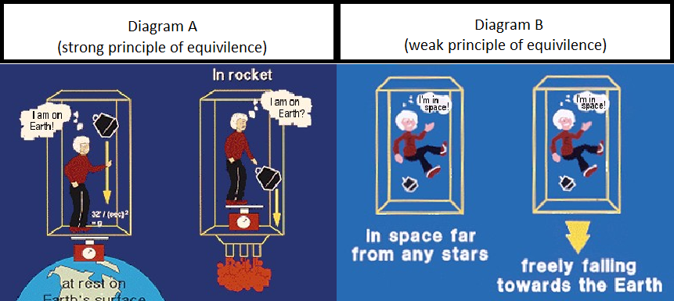
Principle of Equivalence
The centerpiece of the theory of General Relativity (or GR), a uniform gravitational field is indistinguishable from a uniform acceleration
Notes:
2
The starting point for GR is a statement called the “Principle of Equivalence”

Slide 3
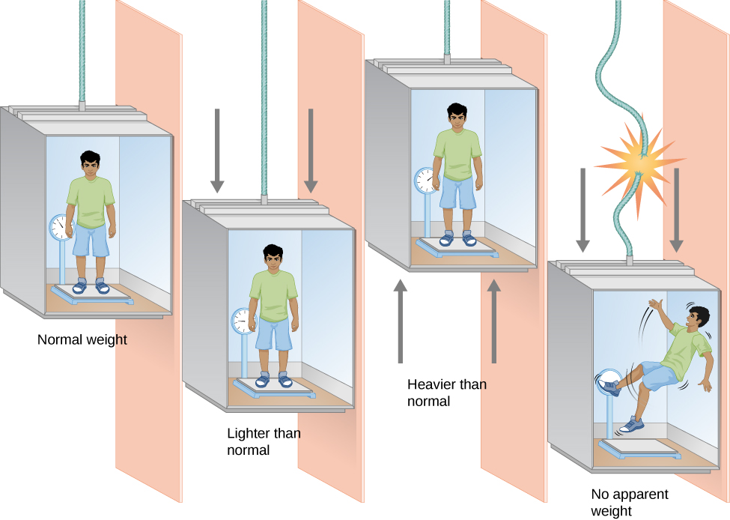
Elevator experiment
First: elevator is under gravity but is supported and not moving.
Second: Elevator is starting to move downwards with acceleration. You are getting lighter.
Third: Elevator is starting to move upwards with acceleration. You feel to be heavier.
Fourth : there is gravity, and the elevator is free-falling: weightless, your weight is 0 (same mass!)
Person in elevator cannot tell the difference between gravitational field and accelerating frame
Notes:
3

Slide 4
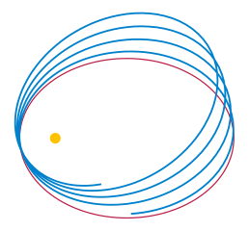
Tests of General Relativity
Orbiting bodies - GR predicts orbits to be different (in blue) from Newtonian model (in red)
Planets move on elliptical orbits - distance to the star is changing; and orbiting object is passing through regions of different space-time curvature
The effect - orbit does not close and each perihelion has moved slightly from the previous position – precession.
Notes:
4

Slide 5
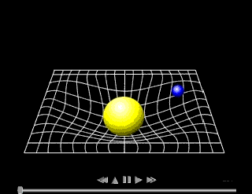
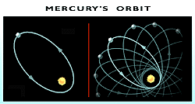
In Solar System, the effect is greatest for Mercury
closest to the Sun
high eccentricity orbit
Mercury’s perihelion position advances by 5600 arc seconds per century.
All but 43 arc seconds can be accounted for by Newtonian effects and the perturbations of other planets.
Einstein was able to account for those 43 arc seconds with the theory of General Relativity.
Curved space-time for Mercury’s orbit around the Sun. Since Mercury’s orbit is elliptical, its distance from the Sun changes. Therefore, it passes through regions of different curvature. This causes the precession of the orbit.
Notes:
5

Slide 6
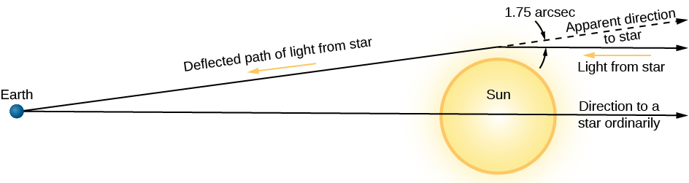
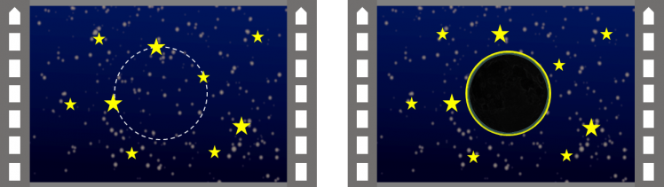
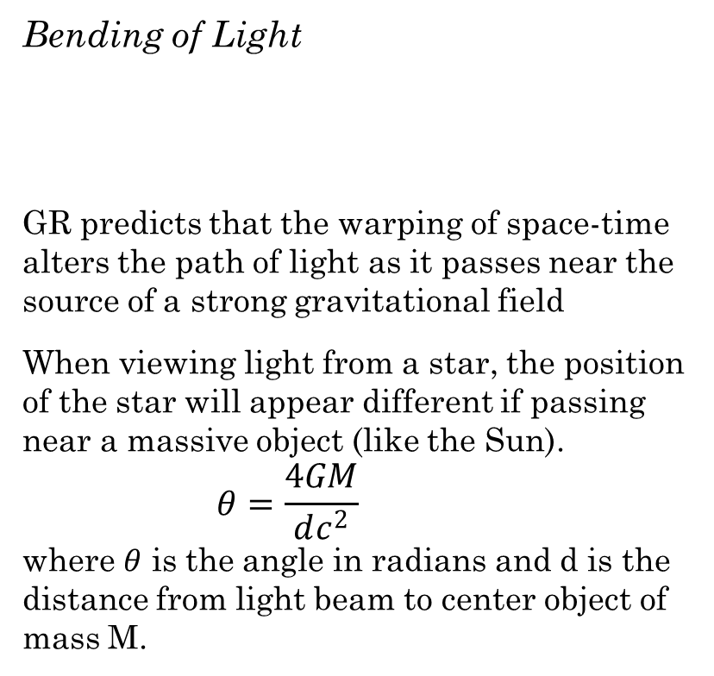
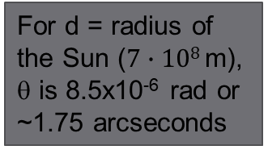
Bending of Light
GR predicts that the warping of space-time alters the path of light as it passes near the source of a strong gravitational field
When viewing light from a star, the position of the star will appear different if passing near a massive object (like the Sun).
      $$θ=\frac{4GM}{dc^{2}}$$
where $θ$ is the angle in radians and d is the distance from light beam to center object of mass M.
For d = radius of the Sun ($7∙108$m), θ is 8.5x10⁻⁶ rad or ~1.75 arcseconds
Measurements must be made during a solar eclipse, when light from Sun is blocked and stars near the Sun’s edge can be seen.
Sir Arthur Eddington headed the attempt to verify Einstein’s prediction during an eclipse on May 29 1919, as the Sun would move in front of a cluster of distant stars to prove this effect.
Notes:
6

Slide 7
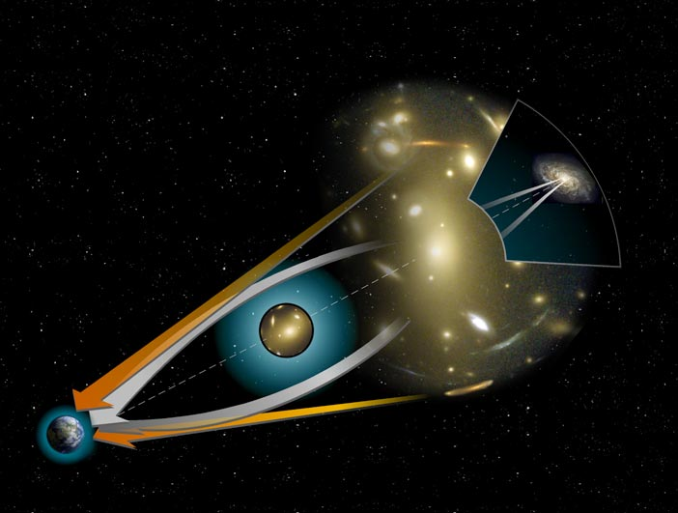
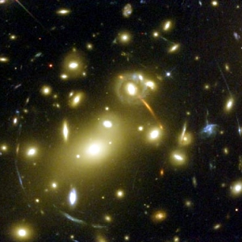
Gravitational Lensing
A large galaxy or cluster can act as a gravitational lens
light emitted from objects behind the lens display distortion and spherical aberration.
Measuring the degree of lensing can be used to calculate the mass of the intervening body.
One of the techniques to detect the presence of dark matter.
Abell 2218
Light waves passing through areas of different mass density in the gravitational lens are refracted to different degrees. Produces double galaxy images and Einstein Rings (if observer, lens, and source are aligned in a specific way).

Slide 8
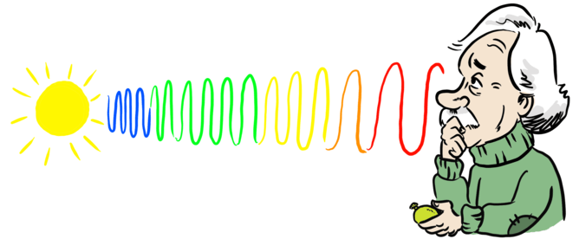
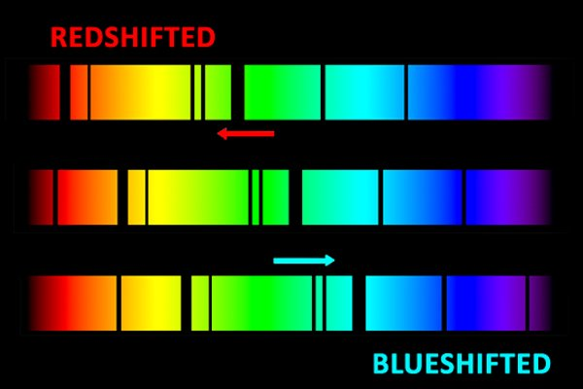
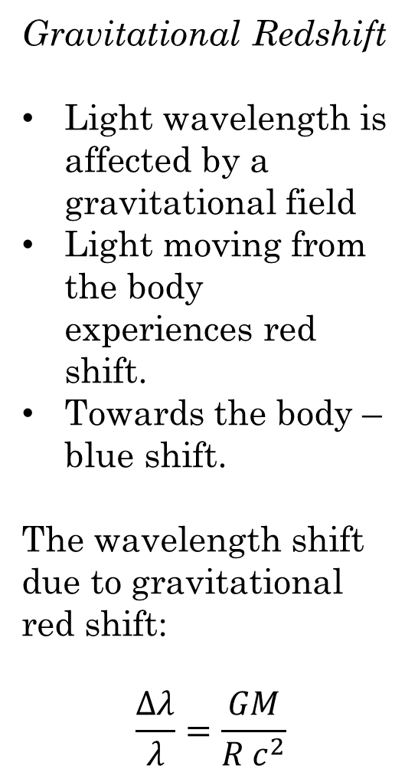
Gravitational Redshift
Light wavelength is affected by a gravitational field
Light moving from the body experiences red shift.
Towards the body – blue shift.
The wavelength shift due to gravitational red shift:
$$\frac{Δλ}{λ}=\frac{GM}{R c^{2}}$$
Notes:
8

Slide 9
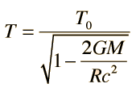

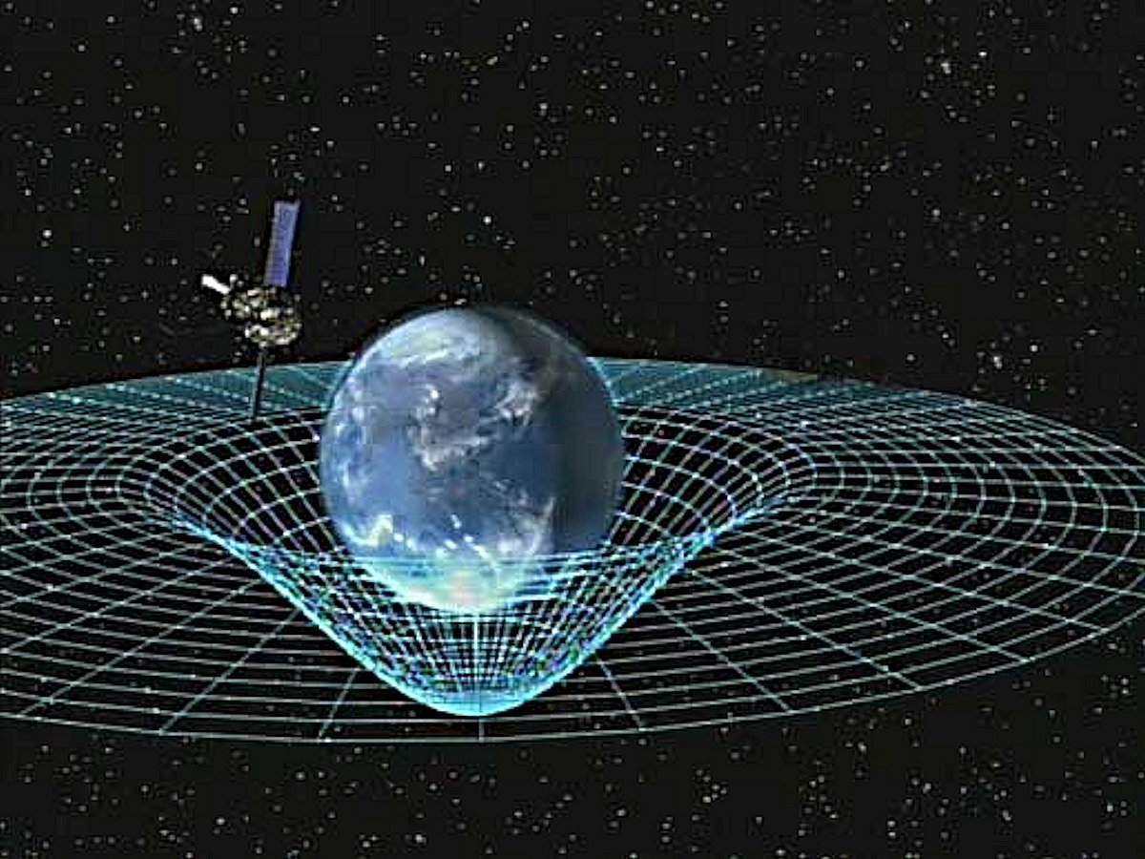
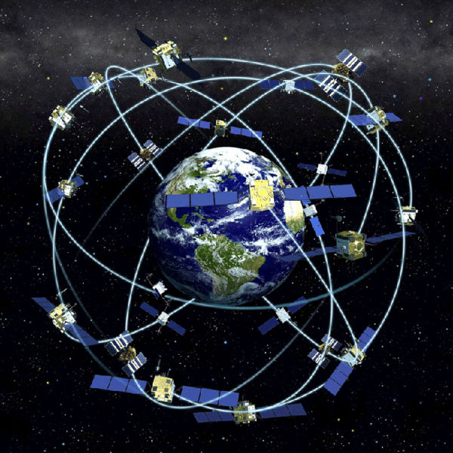
Gravitational Time Dilation
Time run slower in a stronger gravitational field
Gravitational time dilation has been measured using clocks on airplanes, rockets. When the clocks return, they ran slightly faster (ahead) compared to those on the ground.
Time dilation on Earth:
(g – acceleration of free fall)
Notes:
9
Astronauts on ISS age about 0.007 s less than those on the ground – not really noticeable!

Slide 10
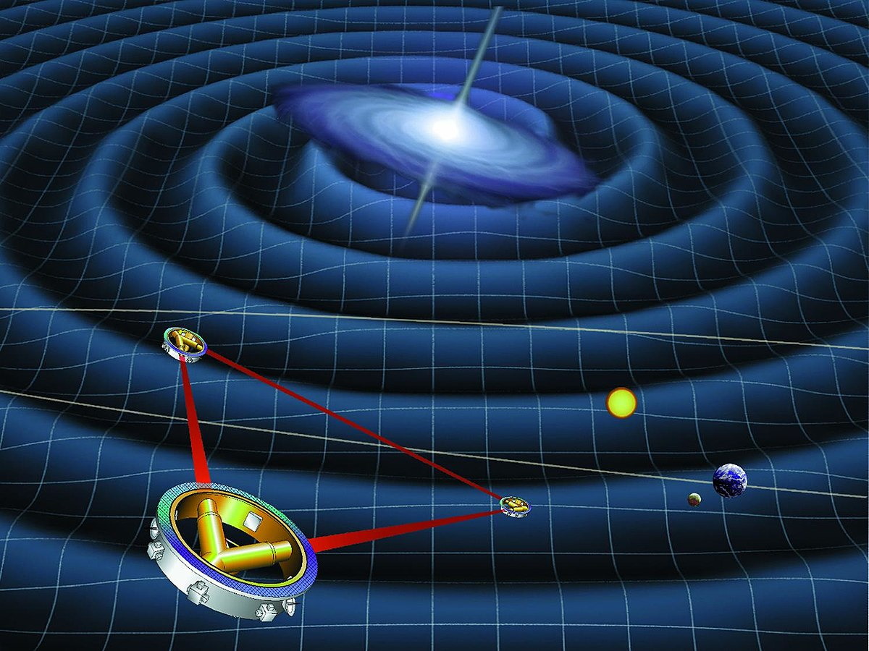
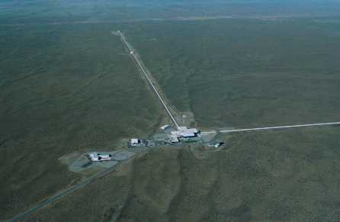
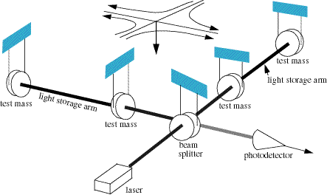
Gravitational Radiation
Accelerated electric charges produce EM radiation
GR predicts that massive systems should emit gravitational radiation.
Massive objects distort spacetime and a moving mass will produce “ripples” in spacetime that should be observable (from two orbiting or colliding stellar remnants like neutron stars, etc.).
LIGO (Laser Interferometer Gravitational-Wave Observatory) is used to detect the waves in space-time using laser interferometry to measure the time it takes light to travel between suspended mirrors. The space-time ripples cause the distance measured by a light beam to change as the gravitational wave passes by.
LISA – NASA’s version in space!
Notes:
10
LIGO – Laser Interferometer Gravity Observatory – Washington State and Louisiana – separated by space to allow to check false signals
Sites separated by 1800 miles with mirrors at each site (interferometer) separated by 2.5 miles
LISA – Laser Interferometer Space Antenna – mirror separated by 3 million miles! About 30 million miles from Earth
NASA discontinued funding in 2011 but NGO (New Gravitational Wave Obs) may still be built

Slide 11
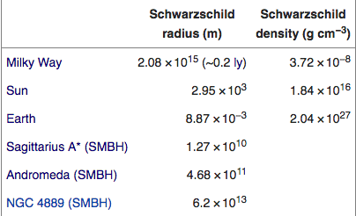
Black Holes
Stellar remnants of the highest mass stars (> 2.5 Solar masses)
The most compact objects in the Universe
the most extreme gravitational fields
Perfect place to investigate the effects of GR
The average density inside a 1 M blackhole is 10¹⁷ g/cm³
Greater than the density of an atomic nucleus!
But, density decreases for more massive BHs
ρ = (1 x 10¹⁷ g/cm³)(M/M)⁻²
Density for 10⁸ M is ~few g/cm³, not much denser than water.
Notes:
11

Slide 12
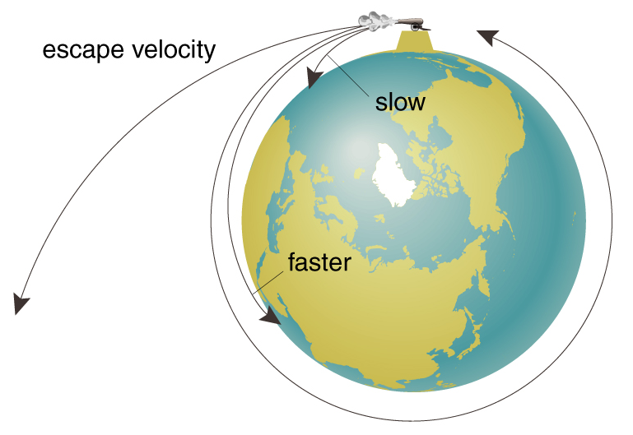
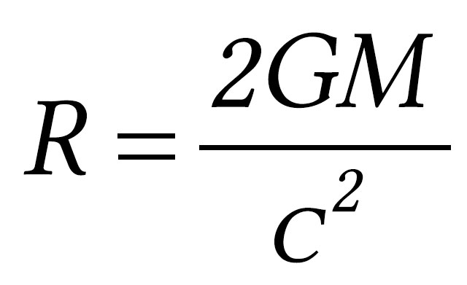
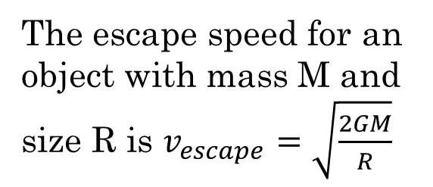
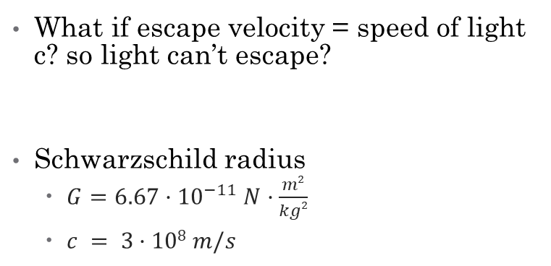
The escape speed for an object with mass M and size R is $v_{escape}=\sqrt{\frac{2GM}{R}}$
For the Sun,
Radius = 700,000 km
V_{esc} = 620 km/s
orbital velocity
What if escape velocity = speed of light c? so light can’t escape?
Schwarzschild radius
  $G=6.67·{10}^{−11} N·\frac{m2}{kg2}$
  $c = 3·108 m/s$
The sphere around a Black Hole at the Schwarzschild Radius is called the “event horizon,” because no event inside that sphere can ever be known outside of it.
Notes:
12

Slide 13
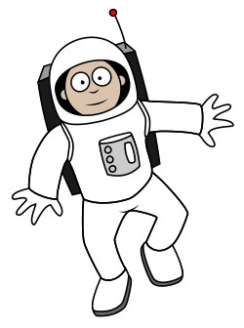
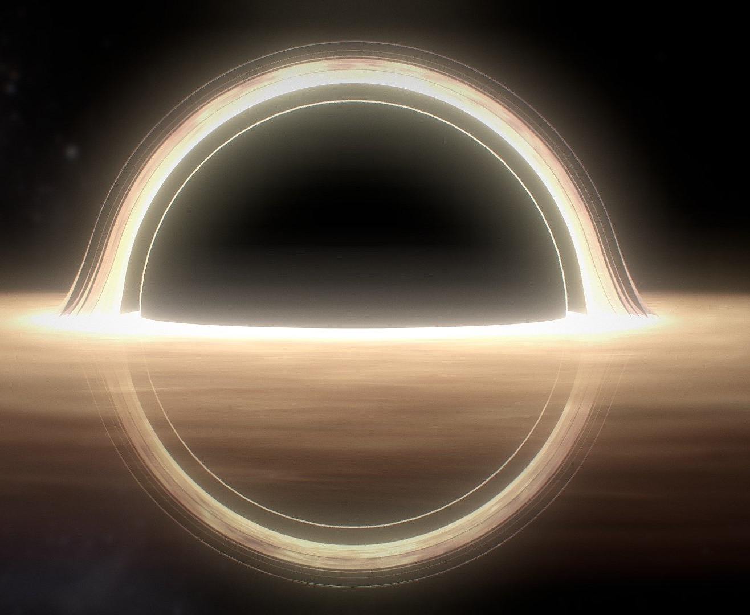
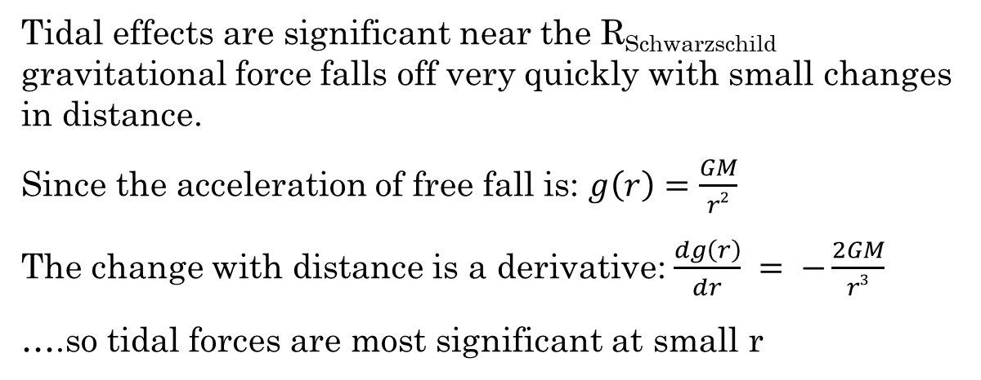
Tidal effects are significant near the R_{Schwarzschild} gravitational force falls off very quickly with small changes in distance.
Since the acceleration of free fall is: $g\left(r\right)=\frac{GM}{r2}$
The change with distance is a derivative: $\frac{dg\left(r\right)}{dr} = −\frac{2GM}{r3}$
….so tidal forces are most significant at small r
What is the difference between the acceleration of gravity at the feet and head of an astronaut just outside a 1 solar mass blackhole?
As you get close to a Black Hole, the previous exercise shows that you would get stretched, then torn apart because the gravitational pull at your feet is 2x10¹² cm/s² greater than at your head (about 2 billion times gravity on Earth!)
Let’s imagine an indestructible astronauts, and give them a clock and a flashlight for their journey to the Black Hole…
Notes:
13

Slide 14


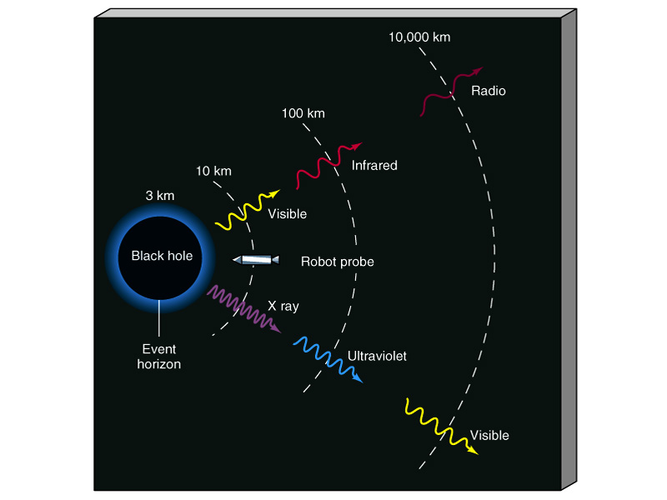
As our astronaut friends approach the Black Hole, we notice that
Their flashlight appears redder and redder (to us).
        The radiation from flashlight gets gravitationally redshifted even more to the infrared and finally radio…
Their clock slows down due to gravitational time dilation.
  At the event horizon, their clock would appear to stop.
    We would never see them cross the event horizon!
What do our astronaut friends see?
Their flashlights looks the same to them.
The clock seems to run at the same speed.
Looking back at us, they see:
Our flashlight gets bluer.
Our clock seems to speed up!
If the astronaut was your twin sibling, after this trip to the Black Hole you would be older than them!
(Your clock really would be running faster than theirs)
Notes:
14

Slide 15
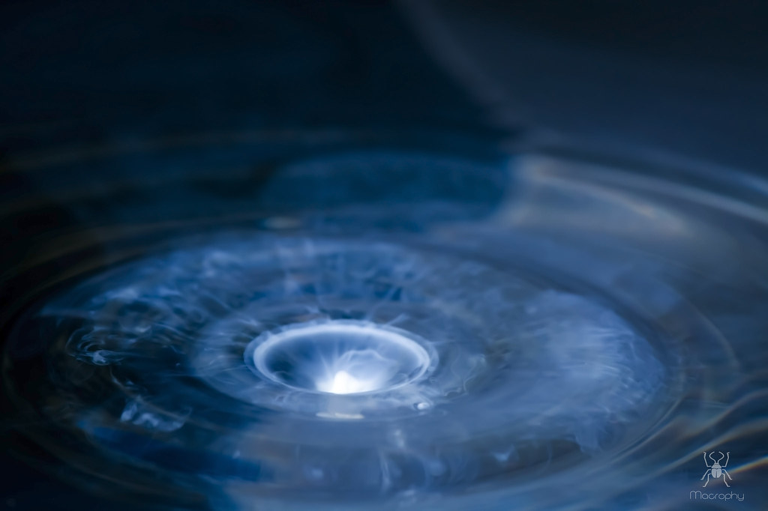
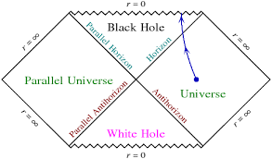
INSIDE THE BLACK HOLE?
What if our friends continued through the Event Horizon?
They would pass through and not perceive the event horizon in any way. With a supermassive blackhole, even the tidal forces might be survivable.
There is no physical boundary there, but they could never come back!
What would our friends find inside the event horizon?
The astronaut would be pulled to the center and crushed down to a point - the singularity
What actually happens is not known, because:
  1) Current theories are not up to the task.
  2) We can never do the experiment! Or get data back.
May be?
Notes:
15

Slide 16
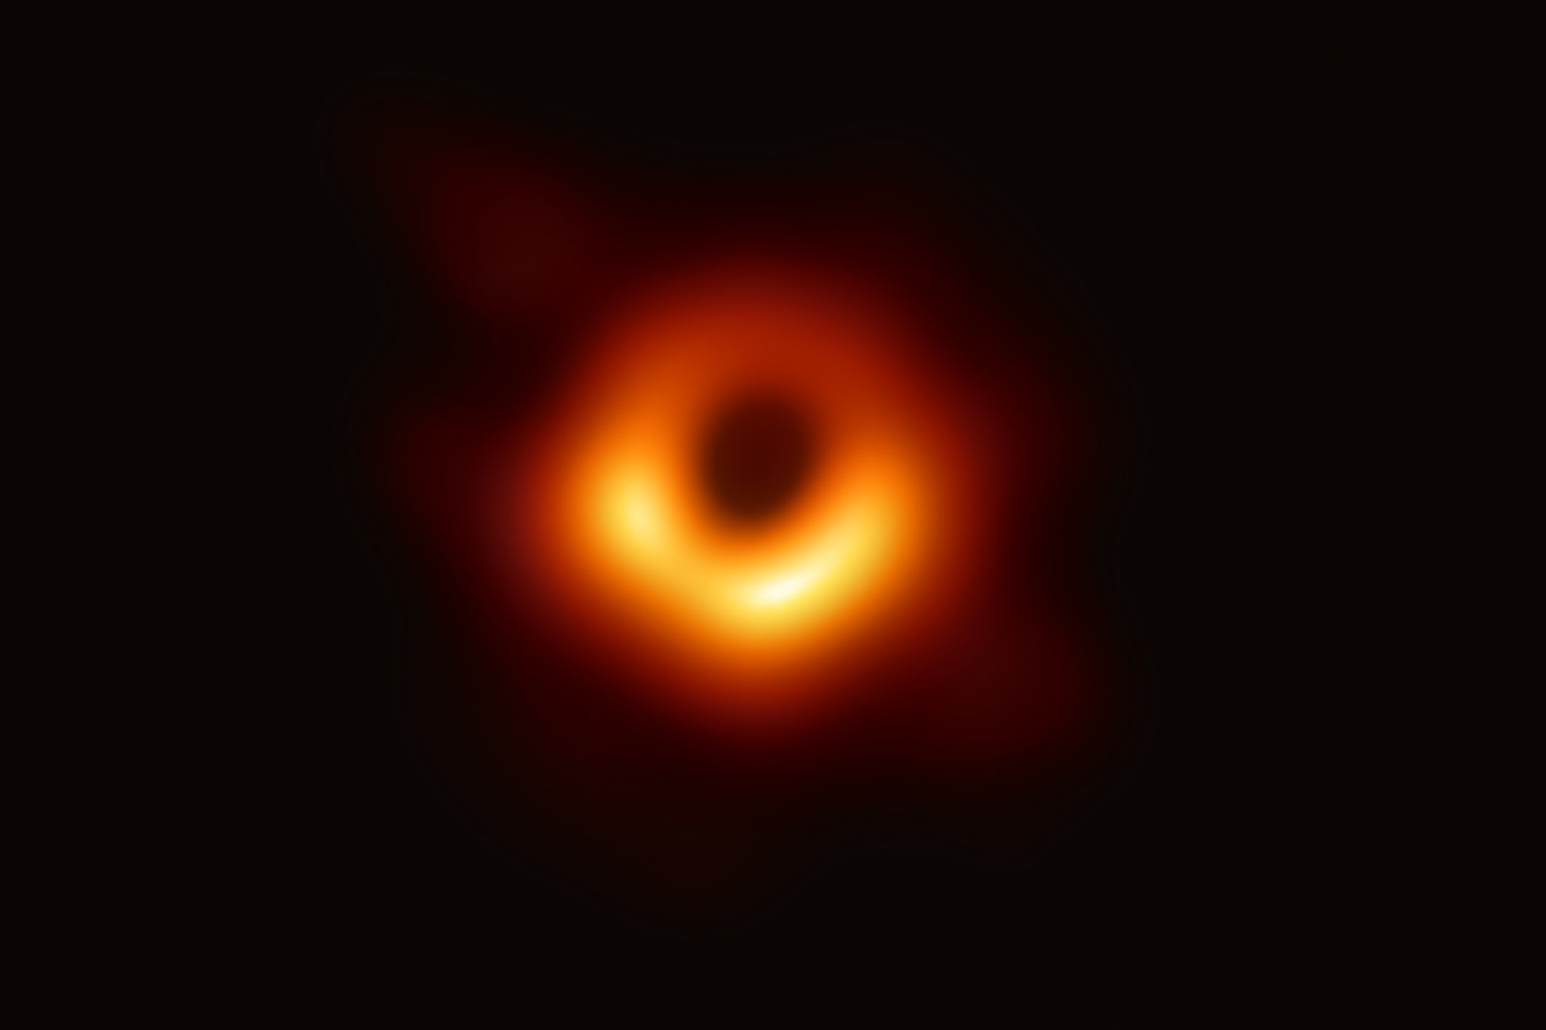
Any Questions?
The actual ‘photograph’ in radio waves of the super-massive black hole
Can we all live in a very, very large black hole?

Slide 17
Backup slides

Slide 18
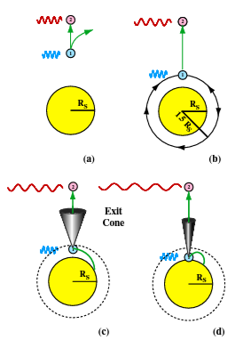
Another effect is seen in the paths of the photons – photons only follow “straight” paths when directed straight up (away) from the blackhole. All other light beams will bend. Only light aimed into the exit cone will escape.
At r = 1.5R_{s}, photons aimed horizontally will orbit the blackhole - photon sphere
For animations and descriptions of the event horizon and photon sphere see
http://apod.nasa.gov/htmltest/rjn_bht.html
Notes:
18

Slide 19
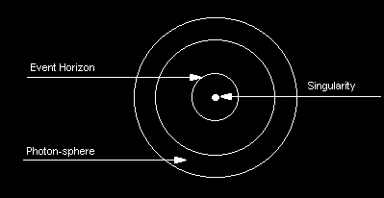
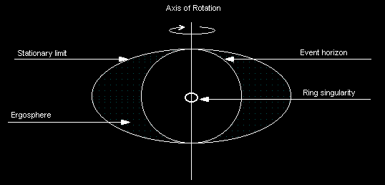
The observer outside the blackhole can not tell anything about what is going on inside the blackhole.
The only properties that can be deduced are its mass, electric charge, and angular momentum: “blackholes have no hair”
Non-rotating BH
In a rotating blackhole, angular momentum is non-zero. The structure differs from non-rotating BH (Kerr found the solutions to Einsteins equations for a rotating BH in 1963).
Stationary limit – objects within this limit will be dragged around BH due to rotation. Objects moving at light speed here would appear “stationary” from outside the limit since the reference frame is moving at light speed. Touches EH (event horizon) at poles and stretches to non-rotating EH value.
Ergosphere - Energy can be extracted from BH via particles in this region moving on specific trajectories – Penrose process (1969)
Rotating BH
Notes:
19

